Slide 1
Module 2
Data Encryption Standard (DES)

Slide 2
Data Encryption Standard (DES)
DES is symmetric-key block cipher published by the National Institute of Standards and Technology (NIST).

Slide 3
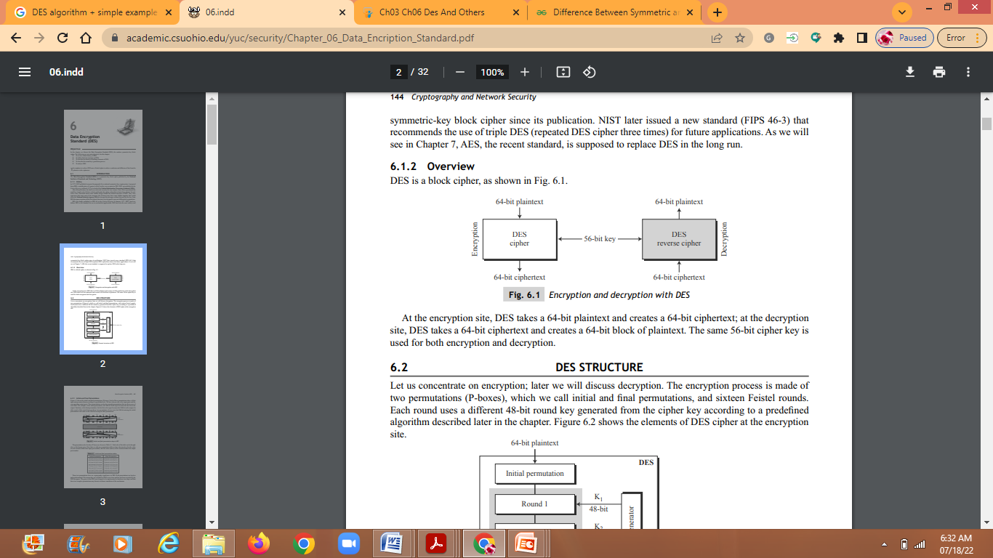
Overview

Slide 4

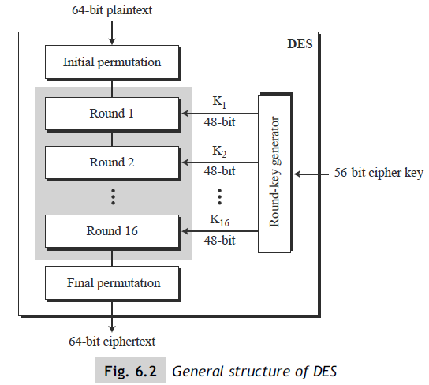
DES STRUCTURE
2 Permutations (P box)
Plain text 64 bits
Key is 56 bits
16 rounds
Feistel cipher

Slide 5
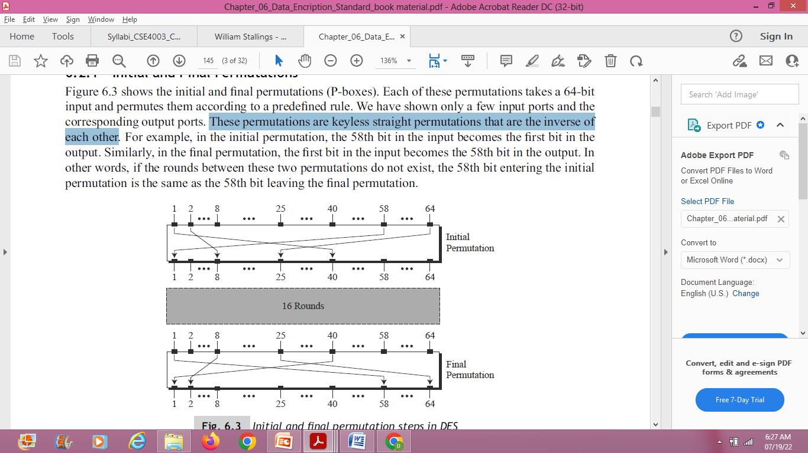
Initial and Final Permutations
Each of these permutations takes a 64-bit input and permutes them according to a predefined rule.
These permutations are keyless straight permutations that are the inverse of each other.

Slide 6
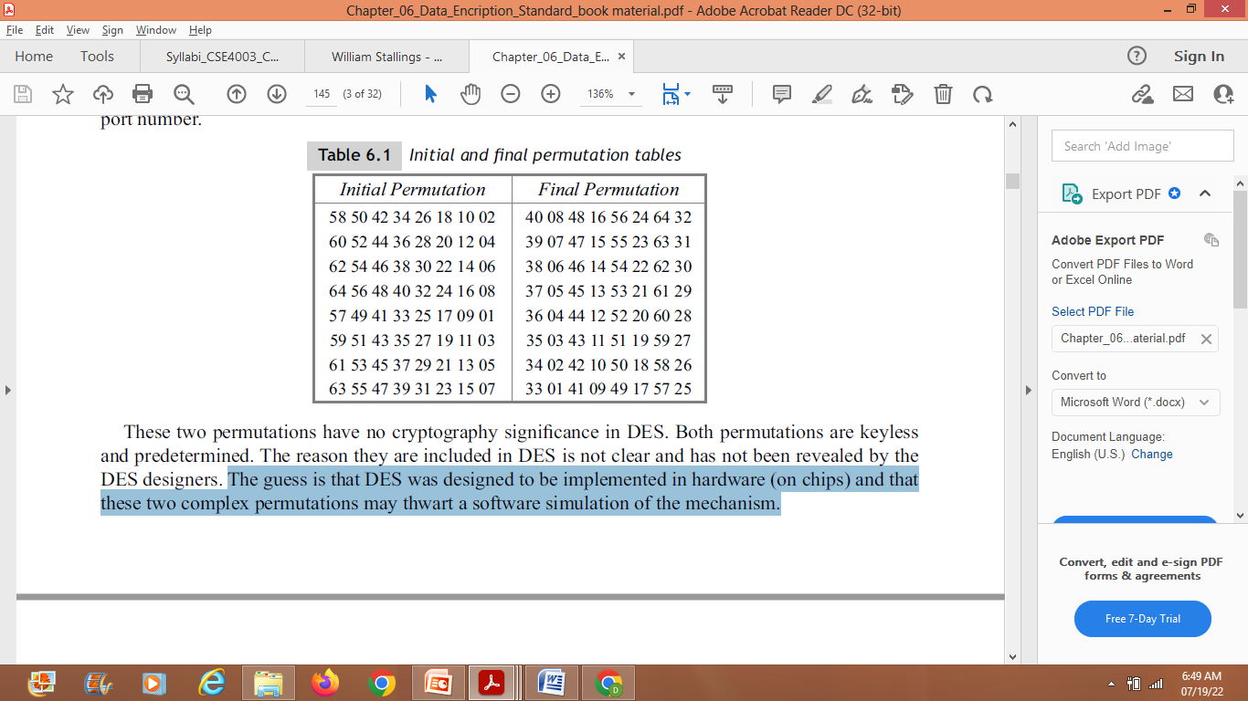
Initial and final permutation tables
The reason they are included in DES is not clear and has not been revealed by the DES designers.
The guess is that DES was designed to be implemented in hardware (on chips) and that these two complex permutations may prevent / deny a software simulation of the mechanism.

Slide 7
Example
Find the output of the initial permutation box when the input is given in hexadecimal as:
0x0002 0000 0000 0001
Solution
0: 0000 (bits 1-4)
0: 0000 (bits 5-8)
0: 0000 (bits 9-12)
2: 0010 (bits 13-16) <--bit 15 is 1
Bits 17-48 are all 0.
0: 0000 (bits 49-52)
0: 0000 (bits 53-56)
0: 0000 (bits 57-60)
1: 0001 (bits 61-64) <--bit 64 is 1

Slide 8
Cont…
The input has only two 1s (bit 15 and bit 64); the output must also have only two 1s (the nature of straight permutation).
we can find the output related to these two bits.
Bit 15 in the input becomes bit 63 in the output.
Bit 64 in the input becomes bit 25 in the output.
0000 0000 0000 0000 0000 0000 1000 0000 (bits 1-32, bit 25 set)
0000 0000 0000 0000 0000 0000 0000 0010 (bits 33-64, bit 63 set)
So the output has only two 1s, bit 25 and bit 63. The result in hexadecimal is
0x0000 0080 0000 0002
The initial and final permutations are straight D-boxes that are inverses of each other and hence are permutations. They have no cryptography significance in DES.

Slide 9
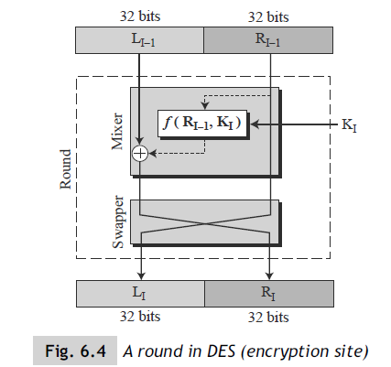
Feistel Structure

Slide 10
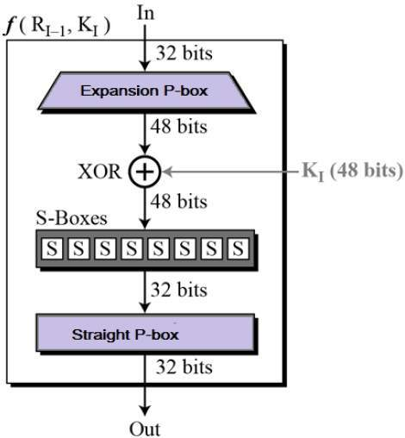
DES Function

Slide 11
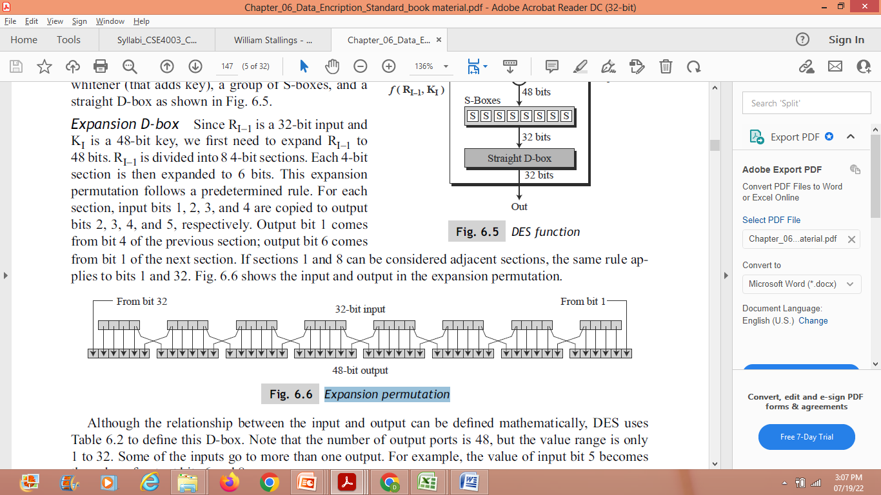
1. Expansion P - Box
RE is divided into 8, 4-bit sections and 4-bit section is then expanded to 6 bits.
For each section, input bits 1, 2, 3, and 4 are copied to output bits 2, 3, 4, and 5, respectively.
Output bit 1 comes from bit 4 of the previous section; output bit 6 comes
from bit 1 of the next section.

Slide 12
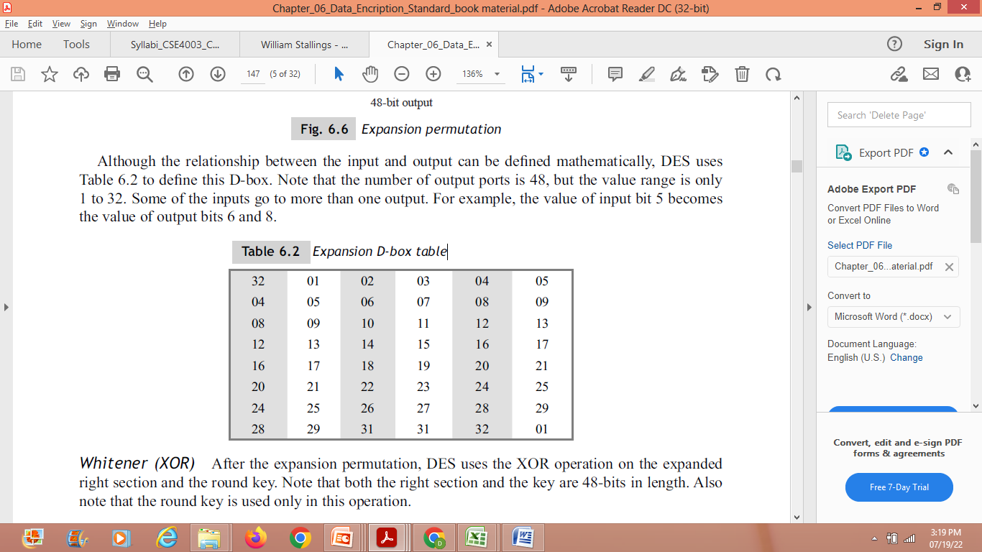
Expansion P-box table
Note that the number of output ports is 48, but the value range is only
1 to 32.

Slide 13
2. Whitener (XOR)
After the expansion permutation, DES uses the XOR operation on the expanded right section and the round key.
Both the right section and keys are 48 bits in length.

Slide 14
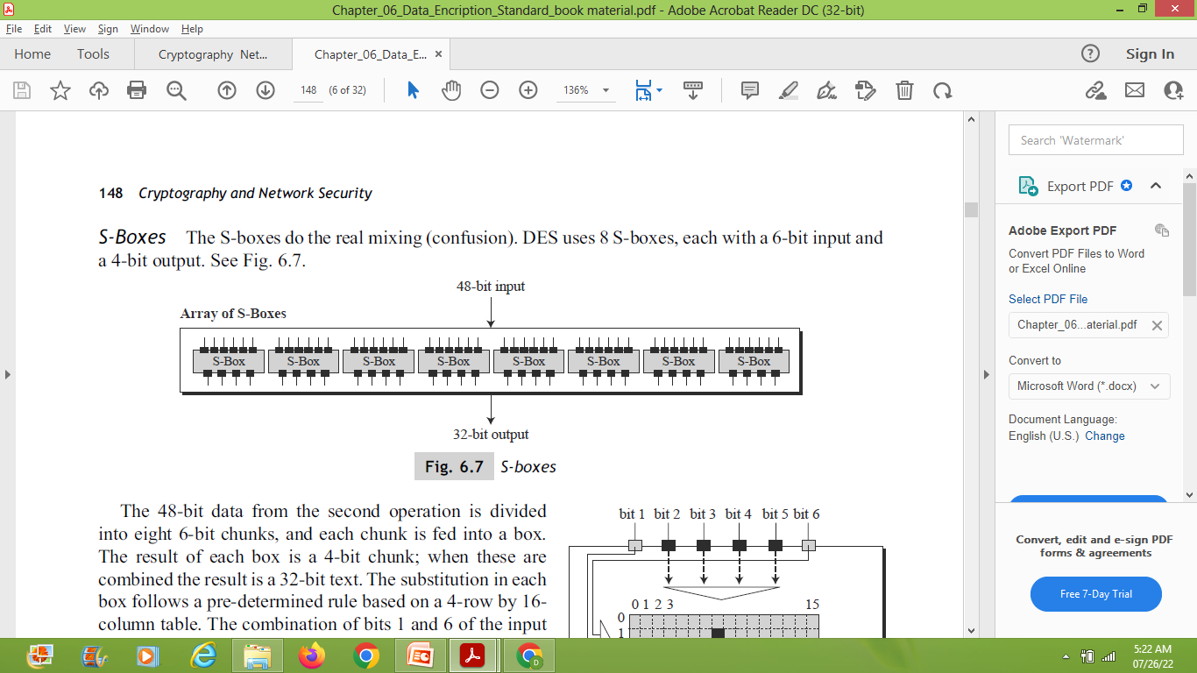
3. Group of S-Boxes
The S-boxes do the real mixing (confusion). DES uses 8 S-boxes, each with a 6-bit input and a 4-bit output.

Slide 15
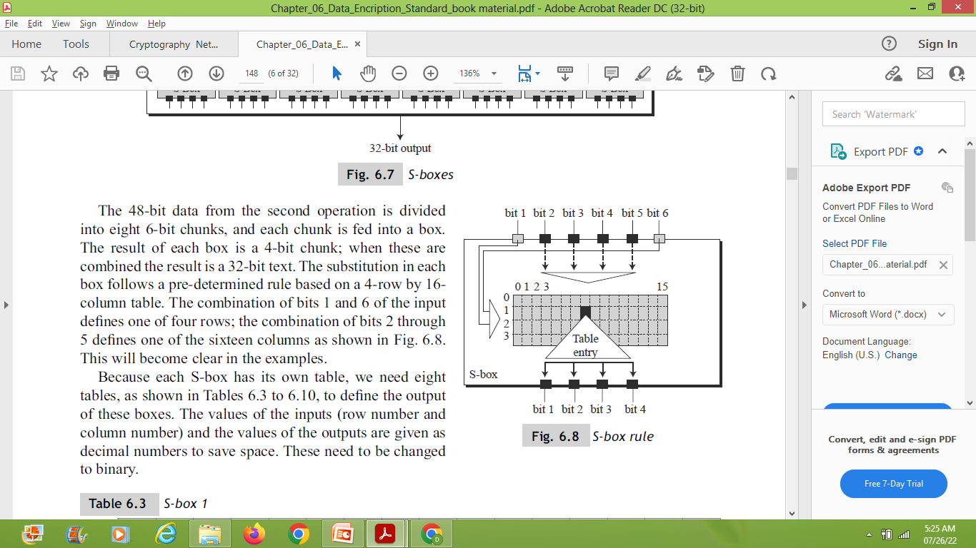
S- Box Rule

Slide 16
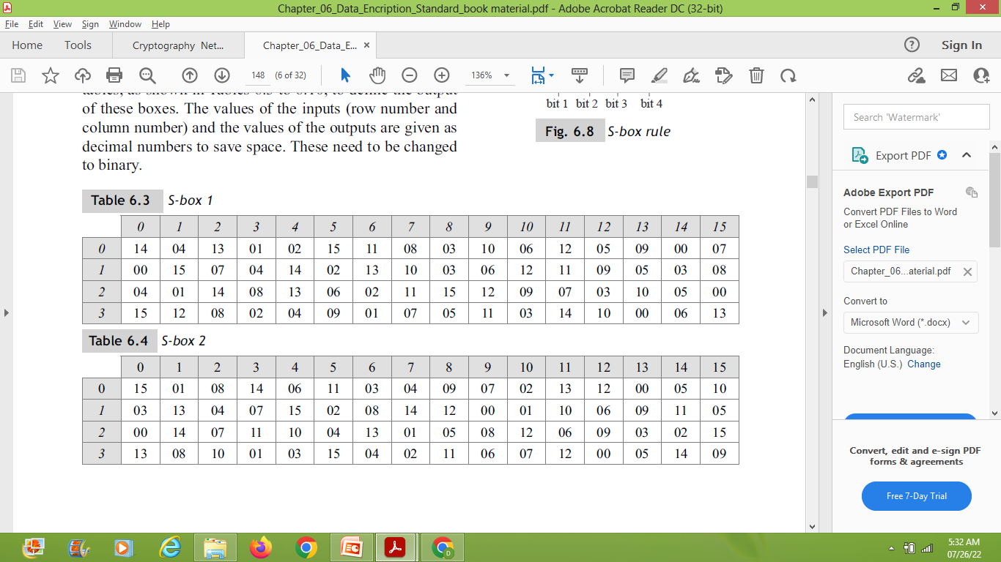
S-Box Tables

Slide 17
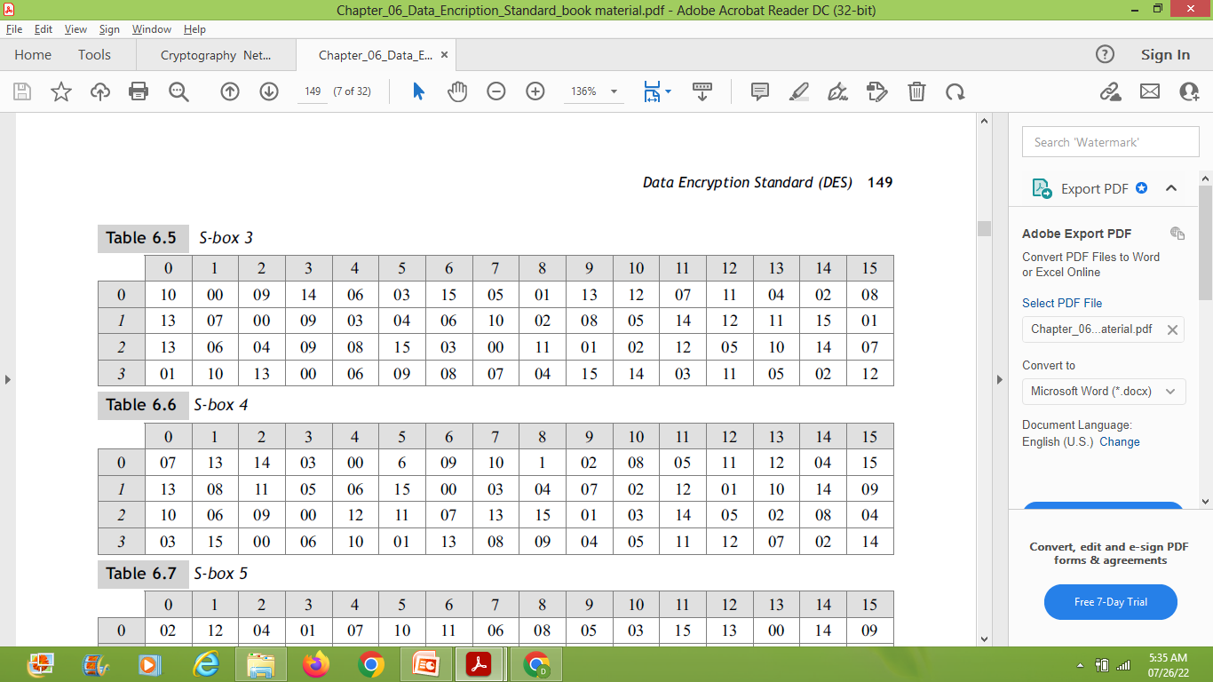
S-Box Tables

Slide 18
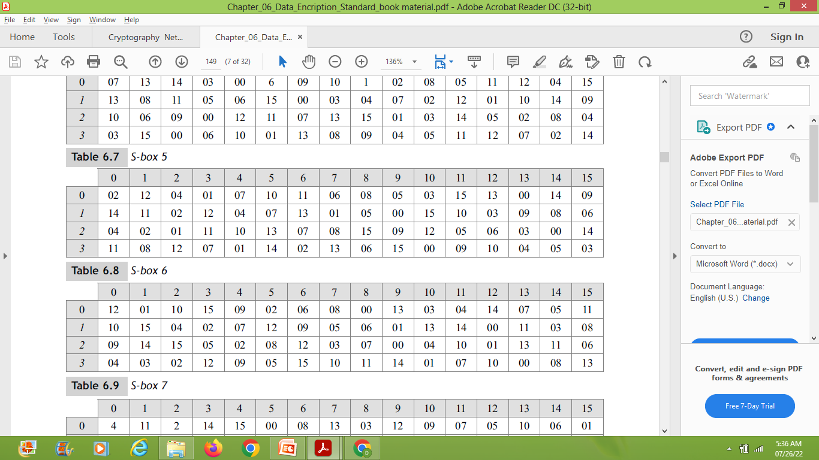
S-Box Tables

Slide 19
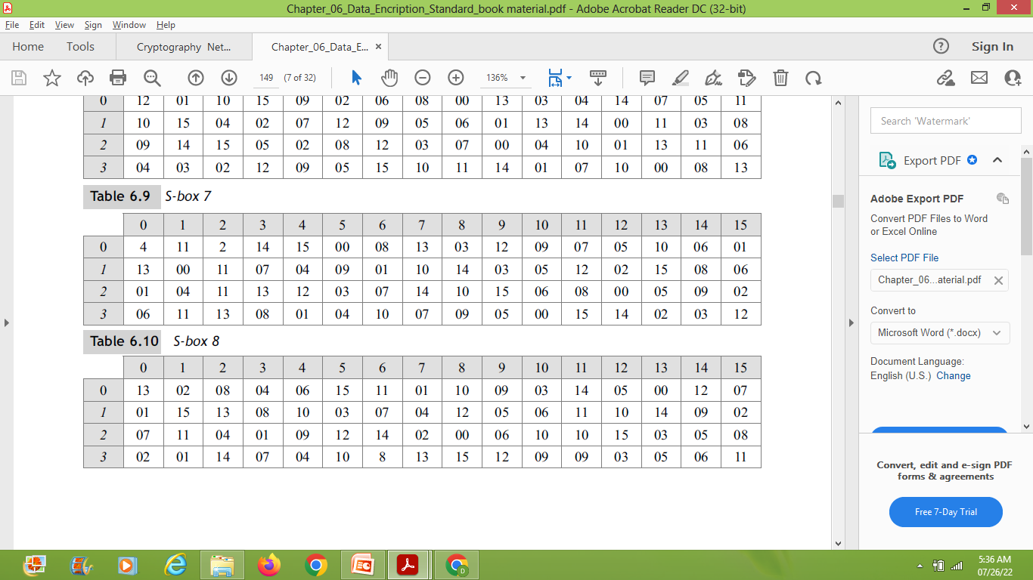
S-Box Tables

Slide 20
Example 1
The input to S-box 1 is 100011. What is the output?
Solution
  100011→ 11 (B) – 3 (D)
  100011→ 0001(B) – 1 (D)
  We look for the value in row 3 & Column 1
  Result is 12 (D) → 1100 (B)

Slide 21
Example 2
The input to S-box 8 is 000000. What is the output?
Solution
  000000→ 00 (B) – 0 (D)
  000000→ 0000(B) – 0 (D)
  We look for the value in row 0 & Column 0
  Result is 13 (D) → 1101 (B)

Slide 22
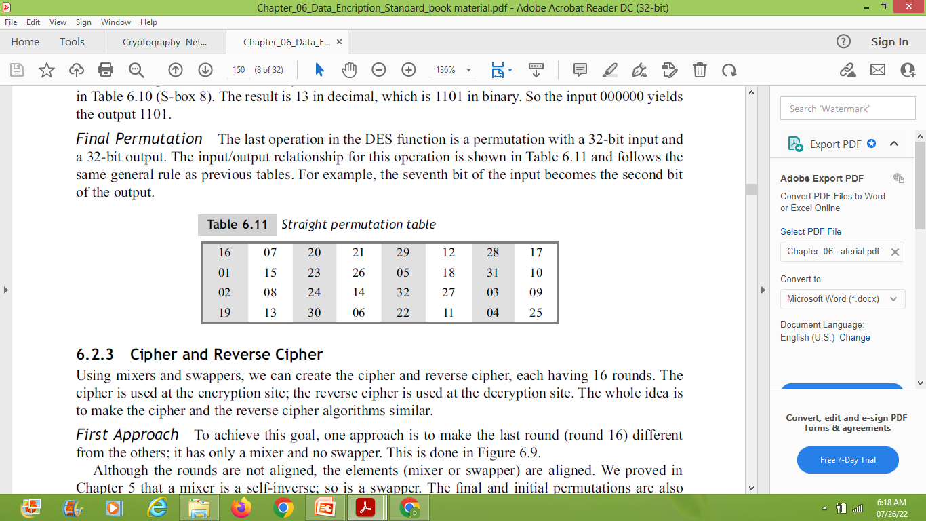
4.Straight P-box
The last operation in the DES function is a permutation with a 32-bit input and a 32-bit output.
For example, the seventh bit of the input becomes the second bit of the output.

Slide 23
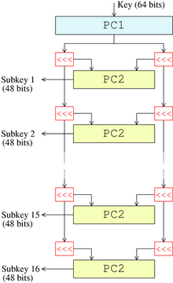

Key schedule (generator):
This algorithm generates the subkeys (K → K₁, K₂…K₁₆).
1- The 56 bits of the key are selected from the initial 64
by Permuted Choice 1 (PC1) table.
2- The 56 bits are divided into two 28-bit halves.
3- In each round, both halves are rotated left by one or
two bits (specified for each round).
4- The 48 subkey bits are selected by Permuted Choice 2 (PC2)
table (24 bits from the left half, and 24 from the right) and used
in each round.
General remarks in the DES:
1- The S-boxes provide the core of the security of DES
and the cipher would be linear, and trivially breakable
without them.
2- The substitution and permutation in the DES provide
confusion and diffusion.
28 bits
56 bits
Key schedule structure

Slide 24
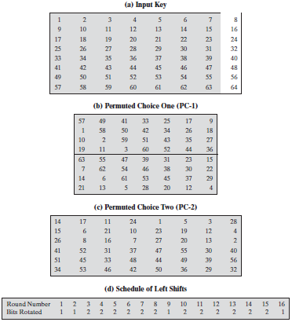
Tables used in DES key generator

Slide 25
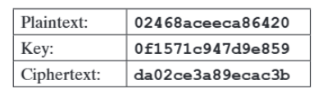
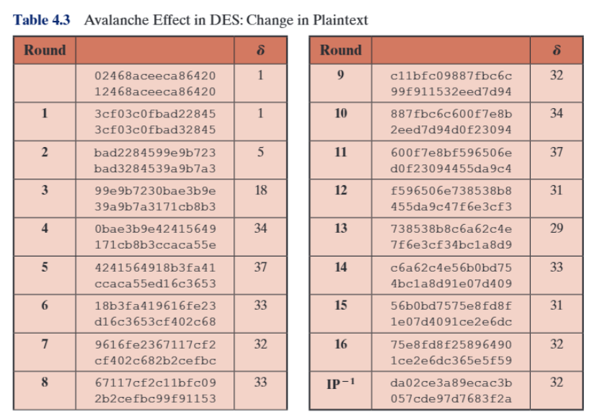

Slide 26
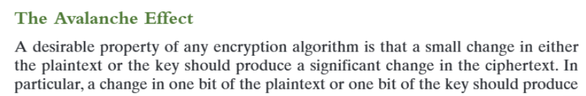
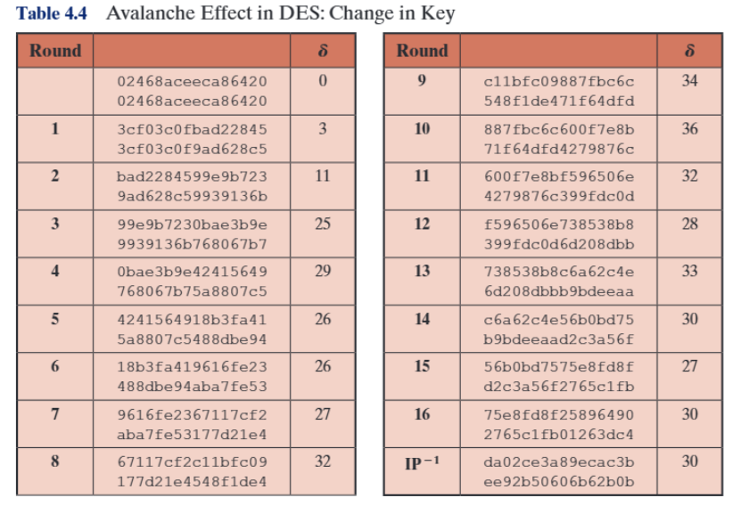

Slide 27
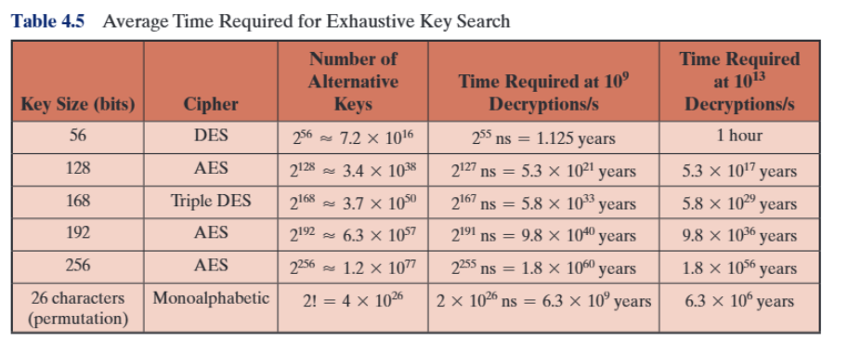
Strength of DES

